Slide 1


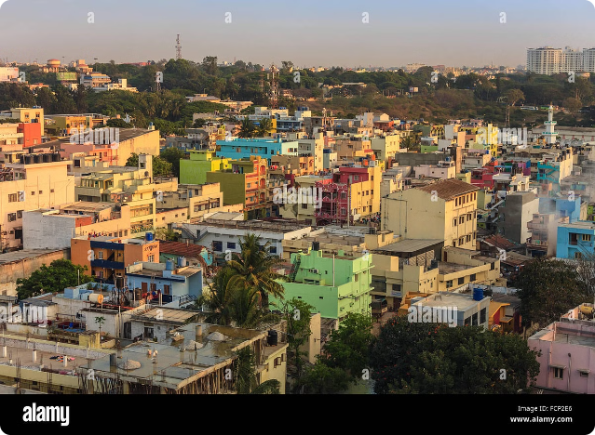


Zomato Bangalore Restaurants Data Set
This data set provides a wealth of information about the diverse restaurant landscape in Bangalore, India. It offers insights into cuisine types, ratings, reviews, and other key attributes that can help us understand this vibrant food scene.
by G Revathi

Slide 2


Data Exploration and Cleaning
1
Inspect Data Structure
Review the data set's columns, data types, and overall organization to identify any inconsistencies or missing values.
2
Handle Null Values
Carefully address null or empty entries to ensure a clean, usable data set for analysis.
3
Standardize Formats
Ensure consistency in formatting across variables like cuisine types, restaurant names, and ratings.

Slide 3
Exploratory Data Analysis
Restaurant Count
Cuisine Diversity
Rating Distribution
Determine the total number of restaurants in the data set to understand the scale of the Bangalore food scene.
Explore the variety of cuisine types represented to get a sense of the culinary options available.
Analyze the distribution of restaurant ratings to identify any patterns or outliers.

Slide 4
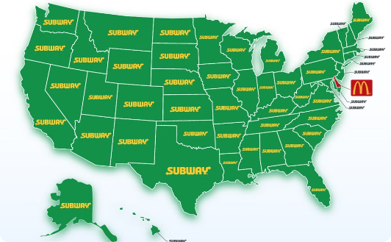
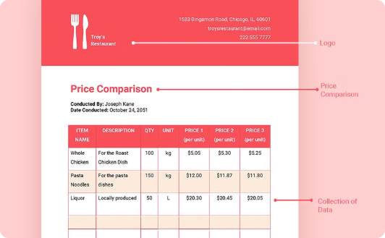

Visualizing Restaurant Attributes
Spatial Distribution
Price Ranges
Amenities and Features
Plot the locations of restaurants on a map to understand their geographic spread across Bangalore.
Visualize the distribution of restaurants across different price points to identify affordable and high-end options.
Showcase the variety of amenities and features offered by Bangalore restaurants, such as parking, Wi-Fi, and reservations.

Slide 5

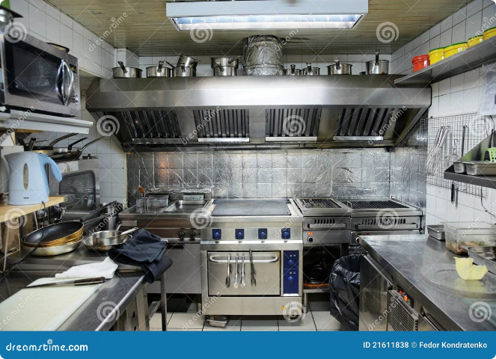
Analyzing Cuisine Types and Preferences
Cuisine Popularity
Identify the most prevalent cuisine types in the data set and explore their relative popularity among Bangalore diners.
Cuisine Ratings
Examine the average ratings for different cuisine types to understand customer preferences and satisfaction levels.
Cuisine Diversity
Investigate the range of cuisine types offered, from traditional Indian dishes to international fare, to paint a comprehensive picture of Bangalore's culinary landscape.
Emerging Trends
Identify any emerging or niche cuisine types that may be gaining popularity in the city.

Slide 6

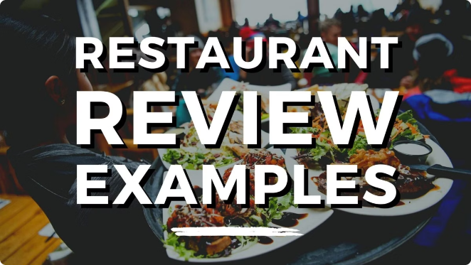
Investigating Restaurant Ratings and Reviews
1
Rating Patterns
Analyze the distribution of restaurant ratings to identify any trends, such as the prevalence of high or low scores.
2
Review Sentiment
Explore the sentiment expressed in customer reviews, whether positive, negative, or neutral, to gauge overall customer satisfaction.
3
Factors Influencing Ratings
Investigate the relationship between restaurant attributes (e.g., cuisine, price range, amenities) and their ratings to uncover key drivers of customer satisfaction.

Slide 7




Identifying Trends and Insights
Emerging Cuisines
Diner Preferences
Geographical Hotspots
Identify any niche or specialized cuisine types that are gaining popularity in Bangalore's diverse food scene.
Analyze customer ratings and reviews to understand the factors that influence diner satisfaction and preferences.
Pinpoint areas within Bangalore with high concentrations of highly-rated restaurants to identify culinary hubs.

Slide 8


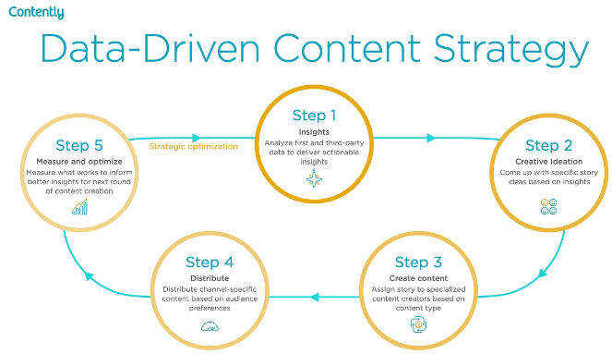


Conclusion and Recommendations
Expansion Opportunities
Identify underserved cuisine types or areas within Bangalore that could benefit from new restaurant openings.
Customer Experience
Provide insights to help restaurants enhance their offerings and improve customer satisfaction.
Data-Driven Decisions
Leverage the insights gained from this analysis to inform strategic business decisions for Zomato and its restaurant partners.

